Slide 1



IMPACT PRODUCT WEBINAR
What's New in Impact
Release Highlights, Admin Branding Tools & What's Next
Notes:
Welcome attendees. Set expectations: today we'll cover what's shipping July 1st, do a live walkthrough of the new self-service branding admin tools, and preview what's coming next on the roadmap — including how customers can get involved in discovery.

Slide 2





AGENDA
What We'll Cover Today
In-House PDF Rendering
Self-Service Designs & Colors
Full migration off the legacy vendor engine — what changes and what stays the same
Live walkthrough of the new branding admin experience
What's Next on the Roadmap
August template UX improvements + items open for customer feedback
2
Notes:
Quick overview of the four sections. Keep this brief — 30 seconds.

Slide 3

NEW FEATURE
In-House PDF Rendering
Impact has fully migrated report PDF generation away from the legacy third-party vendor engine to EverTrue's own in-house renderer.
PDFs generated, stored & delivered entirely within EverTrue — no external dependency
Existing workflows (uploads, templates, proofing, batches) work exactly as before
Validated with Early Adopter institutions ahead of general release
Foundation for faster improvements to report quality & design flexibility
3
Notes:
This is the big behind-the-scenes platform shift — frame it as low-risk for customers since workflows don't change. Mention tickets BIO-484/485/486/521/532/390/395/396/400/413 if asked for detail.

Slide 4



NEW FEATURE
Self-Service Manage Designs & Colors
Customer admins can now manage report designs and brand colors directly — no EverTrue support ticket required.
Designs Tab
Template Fonts & Colors
HEX / RGB / CMYK
Default Colors Tab
View & configure each design — fonts, colors, active/inactive status
Set heading/body fonts and Primary, Secondary, Body colors per design
Live color preview with all three formats shown for print accuracy
Org-wide brand colors that designs inherit unless overridden
4
Notes:
Set up the live demo: 'Let's go take a look at this live.' Transition to the admin walkthrough mockup or live screen share.

Slide 5
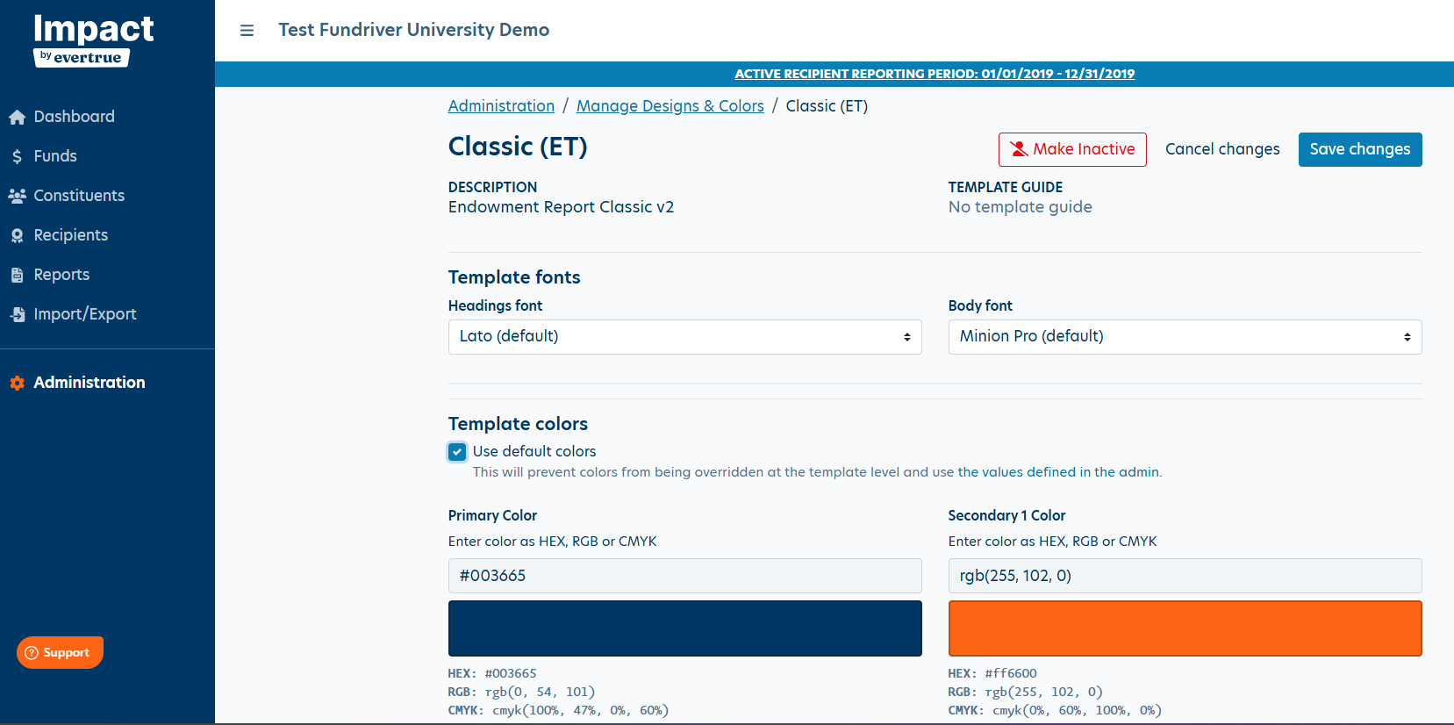
LIVE WALKTHROUGH
Admin View — Manage Designs
5
Notes:
This is a live screenshot from staging — the Classic (ET) design detail view. Walk through: breadcrumb shows Administration > Manage Designs & Colors > Classic (ET). Point out the Make Inactive / Cancel changes / Save changes actions, the Template Fonts dropdowns (Headings/Body), and the Template Colors section — the 'Use default colors' checkbox, Primary and Secondary color fields with HEX/RGB/CMYK shown beneath each swatch.
POINT OUT CMYK / CONFIRM with External Print House we are looking good for printing/ please submit ticket if any issues with the coloring so we can address promptly. NOTE: All colors must be CMYK to keep to PDF as CMYK (when mix then default = RGB).

Slide 6

IMPORTANT — ACTION NEEDED
Legacy Vendor Cutover
With the release today, the legacy vendor design engine is fully decommissioned.
Reports in queue
Legacy vendor batches in queue need review — approval may proceed without regeneration depending on stage
Approval process
Already-produced legacy vendor reports can move through approval without regeneration
Copying prior-year batches
Copying last year's legacy vendor batch for fall reporting will no longer be available — use Classic design going forward
Questions about your queue or fall reporting plan? Reach out to support.impact@evertrue.com
6
Notes:
This is the slide to slow down on. Encourage anyone unsure about their queue to flag it during Q&A or follow up with CS directly.

Slide 7

COMING SOON
Report Template Experience Upgrades
Better image cropping & placement tools, with live preview — so finalizing a report page no longer requires Cropping Services or a full proof run for minor edits.
TODAY
COMING SOON
Cropping & placement require submitting a request to Cropping Services
Built-in cropping & placement tools, directly in the template editor
Hard to fine-tune image position without outside help
Real-time feedback as you adjust an image on the page
Users run a full proof just to see how a minor edit will render
Live page preview reflects edits instantly — no proof required for minor changes
Slower turnaround for last-minute report changes
Users finalize report pages independently, faster
8
Notes:
This is the headline roadmap item. Emphasize the pain points being solved: dependency on Cropping Services and repeated full proof runs for tiny tweaks. IDEALLY Targeted for August.

Slide 8


WE WANT YOUR INPUT
In Discovery — Sign Up to Give Feedback
These items are earlier in the pipeline — we're gathering feedback and would love customer participation before they're built.
Page Ordering
Footer Setting Options
Recipient List Header Flexibility
Signature Photo on Message Page
More flexible control over the order pages appear within a report
Additional configuration for footer content across report templates
Phase 1 — more flexible header options for recipient lists
Ability to include a signature photo within the message page
Want to weigh in on any of these? Please book time with Senior Product Manager https://calendar.app.google/hAujDNCkoPHbuDKn6
9
Notes:
Make a clear ask here: these are open for discovery, and we want customer voices. Point them to CS to sign up.

Slide 9

Questions?
Use the Support widget in your Impact database or email support.impact@evertrue.com for help.
Roadmap Feedback: https://evertrue.fibery.io/@public/forms/EcRrGvsV
or schedule a 30- minute meeting with our Sr. Product Manager: https://calendar.app.google/hAujDNCkoPHbuDKn6
Thank you for joining us today!
10
Notes:
Open the floor for Q&A. Have the legacy vendor cutover slide and the August roadmap slide ready to jump back to if questions land there.

